Slide 1
College of Engineering

Slide 2
Convoys in Atomic and Molecular Trajectories
TEAM 19
Team: Ayden Albertson, Benjamin Hall, Ben McClannahan, TJ Thielen, Benjamin Riemersma
Advisor/Client: Goce Trajcevski

Slide 3
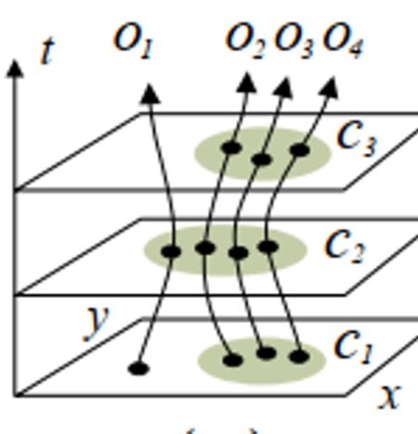
Problem
Chemists and drug manufactures want to detect “convoys” of atoms.​
Atoms from different molecules come close to each other and stay close to each other for a period of time.​
Want to detect the co-moving pattern which persists for a given (user-defined parameter) period of time​.
Want to detect hydrogen bonds with this pattern.
Notes:
Ayden

Slide 4
Vision
Our project aims to develop a system that will allow users to analyze simulation datasets and:
(1) detect the occurrence of such convoys​ and hydrogen bonds
Run convoy detection algorithm on datasets​
(2) provide a detailed report to the user​
Show results of the algorithms to users​
(3) provide a visual representation of the convoys and hydrogen bonds, if they occur within the data set​
Visualize the results of the convoy detection algorithm, 3D model​
Notes:
Ayden

Slide 5
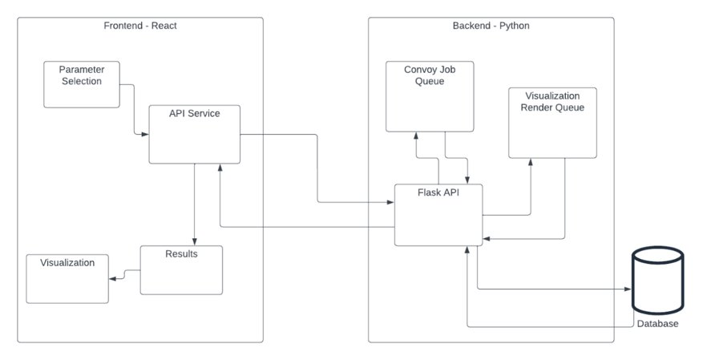
High Level Sketch
As far as we know, there are no comprehensive systems that provide convoy detection and visualization using a cohesive user interface.
Notes:
Ayden / Benjamin Hall

Slide 6
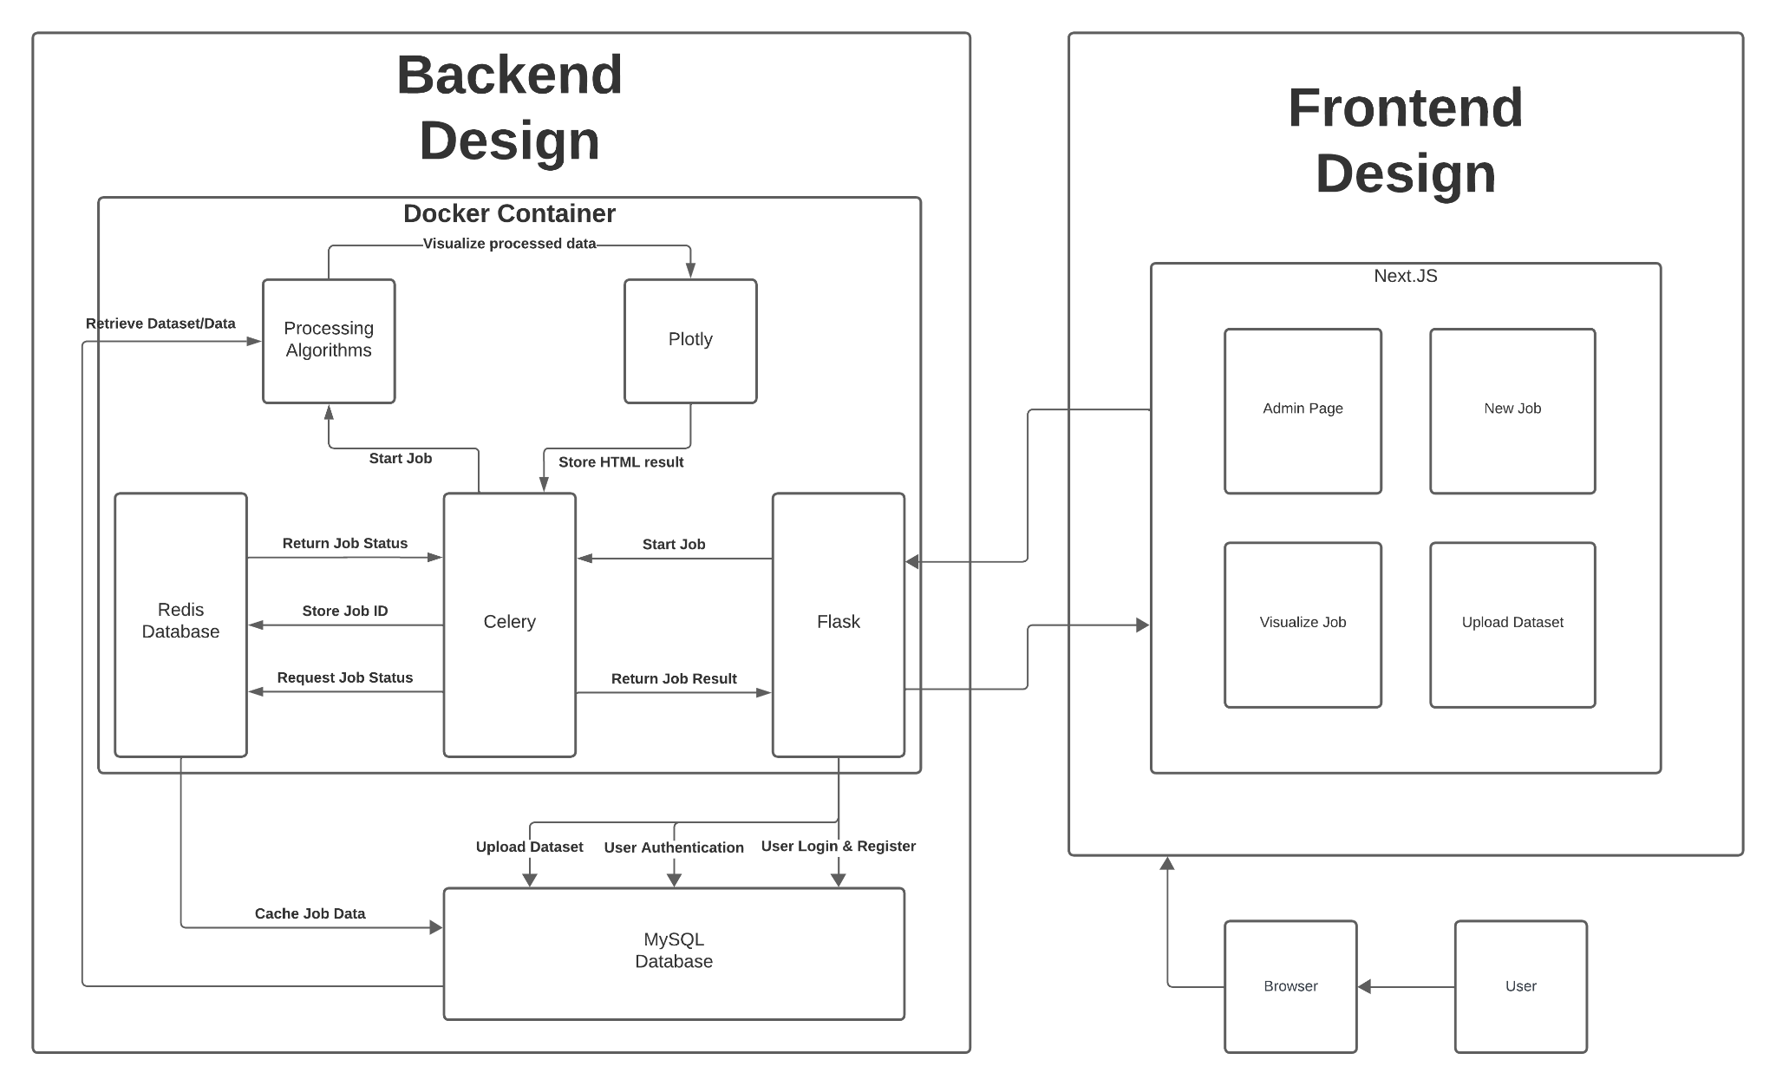
Implementation Architecture (Software)
Notes:
Benjamin Hall / Ayden

Slide 7
Implementation Architecture (Hardware)
Virtual Machine Provided by ETG:
32 GB of Memory
4 Core CPU
Ubuntu 20.04
Notes:
Ben McClannahan

Slide 8
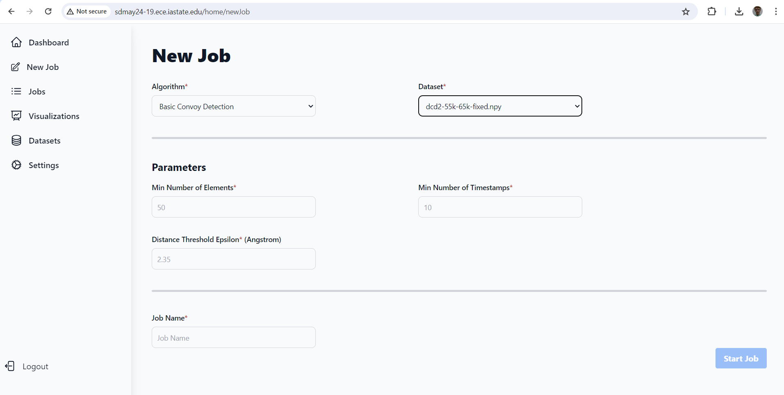
Implementation: UI (Parameter Selection)
Notes:
Ben McClannahan

Slide 9
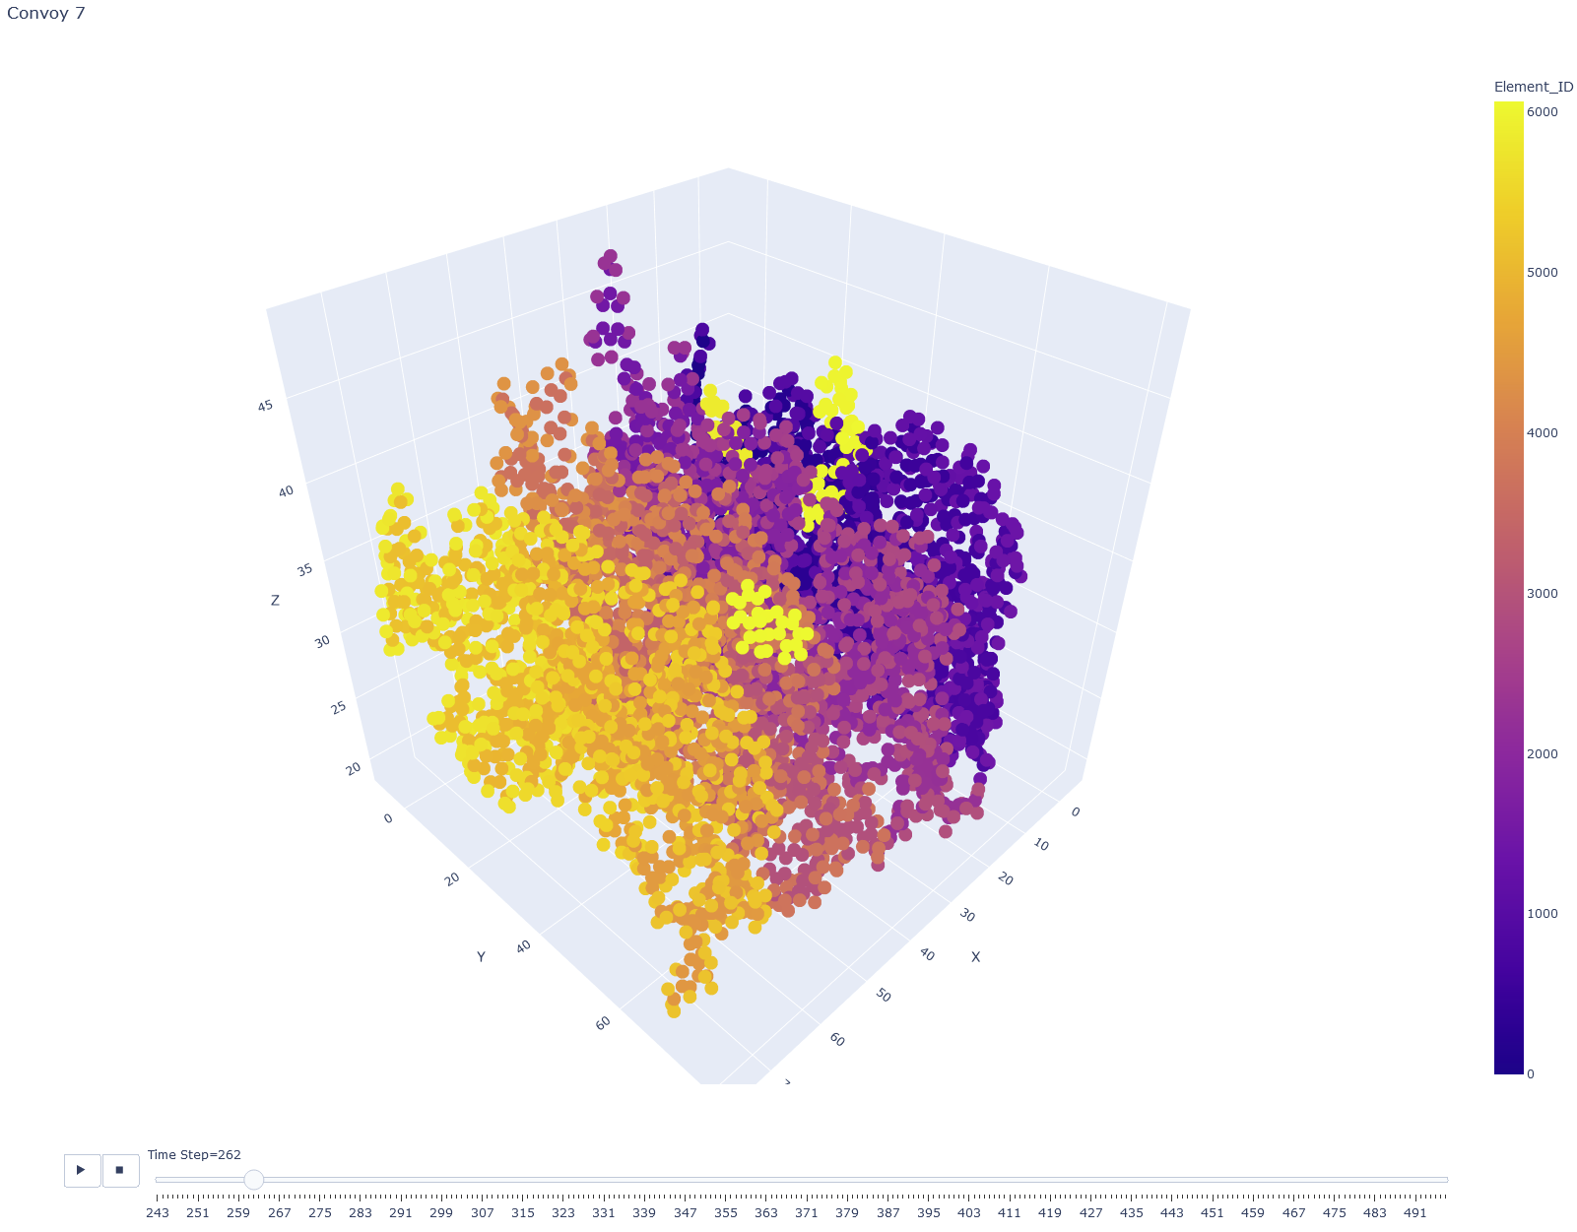
Implementation: UI (Convoy Visualization)
Notes:
Ben R

Slide 10
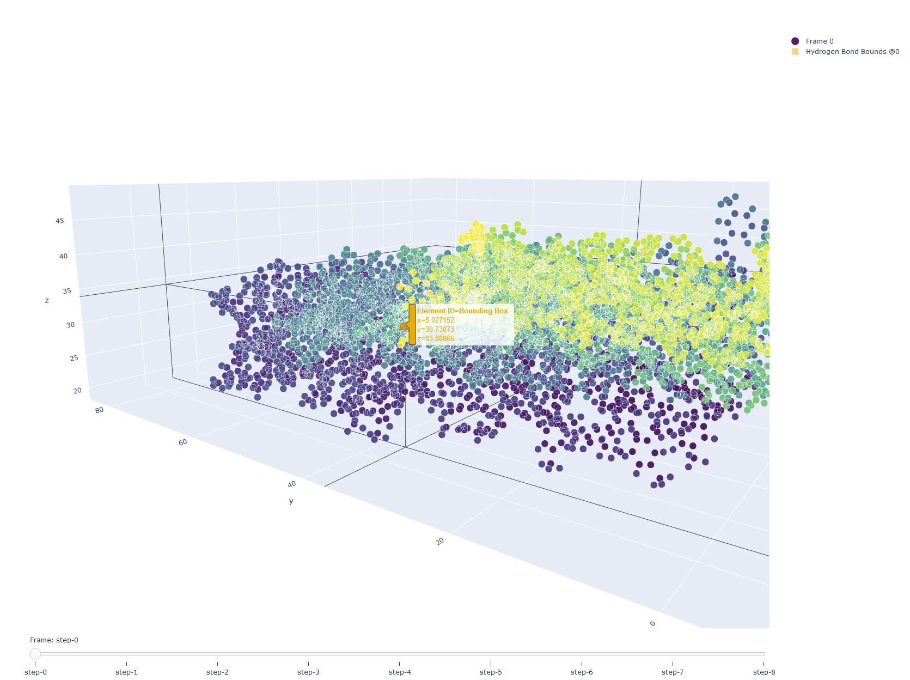
Implementation: UI (Hydrogen Bond Visualization)
Notes:
Ben R

Slide 11
Testing
PyTest & Selenium
Interface Testing
Integration Testing
Regression Testing
Acceptance Testing
System Testing
Security Testing
Notes:
TJ

Slide 12
Accomplishments
Design Robust API
Implement UI Design
Implement complex job queue system
Implement complex algorithms
CI/CD Pipeline
Data visualization in Plotly
Notes:
Ben McClannahan

Slide 13
Key Contributions
Ayden Albertsen: Plotly visualization, NextJS setup, Frontend Design, database management, CI/CD
Benjamin Hall: Flask backend setup, Celery setup, Plotly visualization, database management
TJ Thielen: Sign in Page, Admin Page, Continuous Integration Gitlab Runner
Ben McClannahan: Job Info
Benjamin Riemersma: Visualization integration, VM initial setup
Notes:
TJ

Slide 14
Challenges and Solutions
Use of React (performance)
Solution: Migrate to NextJS (Server Side Rendering)
Desynchronization of databases
Solution: Cache Redis tables in MySQL
Plotly Express not configurable enough
Solution: Custom implementation of Plotly library elements
Notes:
Benjamin Hall

Slide 15
Future Developments
Enhanced detection algorithms
Faster visualization
Open source Plotly library development
Dataset sharing service
Increased automated server maintenance tools
Notes:
Ben R

Slide 16
Conclusions
Flask API
React/Nextjs
Celery Job Queue
Redis Broker
Docker
Molecular Visualization
Notes:
TJ

Slide 17
Demo (If time allows)

Slide 18
Questions?

